Slide 1
Marriage Equality 2023
Research Report for HKME

Slide 2
Contents
03.
06.
43.
Background
Detailed
Findings
Summary
Values & Meaning of Marriage – 7
Perception to LGBT+ & Same Sex Marriage – 13
Deep Dive in “Moveable Middles” – 19
Deep Dive in “Mildly Supportives” – 25
Reaction to LGBT+ Communication – 30

Slide 3
Background
© Ipsos

Slide 4
Background & Objectives
Background
Business Question
Research Objectives
Since the previous study in 2019, there has been few higher profile incidents related to the LGBT+ community in HK, including court cases and LGBT+ focused mainstream media programs.
HKME is keen in understanding whether the new incidents has led to any change in mindset. By comparing the point of views among the sticky vs loosened ‘movable middle’, we hope to identify potential motivators to gain more support in marriage equality.
Values and impact on attitudes towards LGBT+ and their marriage rights
Awareness, concerns and acceptance to different rights for same-sex couples
Impact of mass media communication on their views in LGBT+ community and same-sex marriage

Slide 5
Research Design
A total of 6 focus groups were conducted between 12th and 14th April 2023 at Ipsos office in Hong Kong:
Group composition
Group 1 | Young adults | Age 30-40, mix of male and female, fair mix of no kids and with kids | Mildly supportive or “recently moved middle”
Group 2 |  |  | “Moveable middle”
Group 3 | Mature adults | Age 41-55, mainly married and have kids (1-2 candidates with no kids) | Mildly supportive or “recently moved middle”
Group 4 |  |  | “Moveable middle”
Group 5 | Elders | Aged 56-70, mainly married and have kids (1-2 candidates with no kids) | Mildly supportive or “recently moved middle”
Group 6 |  |  | “Moveable middle”
Sample Definition for “Movable Middle”
Screened by their acceptance on LGBT and Same Sex Marriage as below.
“Recently moved middle” are those who declared not acceptance in the past while have become accepting in the past few years
 | ACCEPT LGBT | TOLERATE LGBT | NOT ACCEPT LGBT
ACCEPT Same Sex Marriage | Screen out | Screen out | Screen out
UNDECIDED to Same Sex Marriage | Qualify as ‘movable’ | Qualify as ‘movable’ | Screen out
NOT ACCEPT Same Sex Marriage | Qualify as ‘movable’ | Qualify as ‘movable’ | Screen out

Slide 6
Detailed findings
© Ipsos

Slide 7
Values & Meaning of Marriage

Slide 8
Values overview
These are the core values and attitude towards life…
Tolerance
寬容
包容
Inclusion
Respect
Equity
平等
尊重
同理心
Empathy
Responsible
負責任
Harmony
Equality
善良
Kind
和諧
公平
Filial piety
孝順
中庸
Golden mean
感恩
Grateful
Honest
誠實
獨立
Independent
正直
Integrity
Freedom
自由

Slide 9
The society seeks to be more peaceful with less conflicts.
Findings from 2023 – mix of “recent accepters” and “moveable middles”
Respect, harmony and empathy are the most commonly mentioned values, with a small segment difference.
Respect. Particularly high mentions among the two elder groups, due to a new culture that marginalizes elder’s perspectives, which conflicts with the traditional Chinese value.
Harmony & Empathy. More commonly seen in the two young groups. They find these values necessary to reduce conflicts and maintain social relationship with those who have different political and social values.
近呢幾年睇好多新聞都係因為一啲口角，跟住就會打交，變成一單血案。我覺得如果大家可能靜落嚟，平心靜氣多啲，和諧多啲，可能就會少啲呢啲事情發生
Findings from 2019 – “moveable middles” only
There are many news that people get into fights and blood is shed due to small arguments. If the society can be more calm and more harmonic, such incidents will be reduced.
[Aged 30-40, Female, Mildly Supportive]
只要某個人做啲嘢唔影響到我，對我冇乜利益衝突，我就應該尊重佢地嘅決定。
If I am not affected by their action and there is no conflict of interest against me, I shall respect their decision.
[Aged 56-70, Male, Moveable Middle]
Notes:
-香港社會好缺乏和諧，啲人郁一郁就想殺人咁，尤其我鍾意睇東張西望，而家啲人好容易辣著。呢個社會好需要大家settle down、和諧啲，其實係要政府做嘢，安撫人心，e.g.起公屋，大家照顧左啲老弱病殘先，大家心情都舒緩啲唔會咁暴躁，大家都係為錢姐

Slide 10
There is no particular difference in the view of marriage between moveable middles and mildly supportives.
Findings from 2019 – “moveable middles” only
There is no particular difference what marriage means between moveable middles and mildly supportives.
Both groups see marriage as a demonstration of commitment to the other half as their life-long companion.
Marriage symbolizes commitment & accountability.
Commitment. Only few literally expressed marriage as a result of love, majority sees marriage as a commitment to other half.
Recognition. Female tend to have higher anticipation towards marriage as it is a recognition of being someone’s significant half.
Determination. Relatively, male tend to see marriage a serious decision as one would be accountable to the other half for the rest of life.
Companionship. Love is only literally mentioned by few people, although marriage is based on the foundation of showing love and care to others. Majority sees companionship is a better representation of marriage relationship.
結婚係一個雙方嘅承諾，大家維持一個關係，去面對一啲嘢，一齊共同生活。
Marriage is a bilateral commitment, that we sustain a relationship to face something together and to live together.
[Aged 41-55, Female, Moveable Middle]
第時老咗會有個依靠，有個穩定嘅老伴。
To have someone to rely one when I am old; to have a stable companion.
[Aged 30-40, Female, Mildly Supportive]
我呢代係做朋友、拍拖、相愛、結婚，山盟海誓，會照顧大家一生一世，唔會始亂終棄，所以我而家都堅持我嘅承諾。
For my generation, we went by being friends, dating, in love, then marriage. We vowed to care for each other the whole life and will not abandon the others. I still hold on to my commitment.
[Aged 56-70, Male, Moveable Middle]
Notes:
-婚姻都代表咗對伴侶嘅忠誠，有個定位喺度，當然佢可以偷食，但始終會有個度喺度，除非真係好冇擔當，咁就冇辦法
56-70. Female. Mildly supportive
-我呢代係做朋友、拍拖、相愛、結婚，山盟海誓，會照顧大家一生一世，唔會始亂終棄，所以我而家都堅持我嘅承諾

Slide 11
The meaning of marriage is changing. The younger generation finds less social pressure in getting married.
Elder groups
Younger groups
A milestone in life
To legitimately live together.
To provide protection to female
Practical needs (visa, document signing, etc.)
Religious need
我地嗰代就係結婚，跟住生小朋友，係一個過程嚟
我個男朋友唔系香港人嚟嘅，咁我就要結婚，先可以實際搞visa
Get married and then have kids. It is part of the process.
[Aged 55-70, Female, Moveable Middle]
My boyfriend is not a HK resident. I need to get married to get a visa.
[Aged 30-40, Female, Mildly Supportive]
喺香港呢個現實環境，財產上或者福利上，好像交稅免稅額，需要有一個婚姻嘅合法性，要同對方有個身份先可以攞。
適婚年齡，我地嗰個年代會係簽紙，唔係同居。結婚就係正式承認段關係，要住埋一齊了
Under the realistic environment of HK, for wealth or welfare like tax allowance, it requires a legitimate marital relationship. Your partner needs to have the status to claim the benefits.
[Aged 30-40, Male, Mildly Supportive]
At the right age, we would get married instead of cohabit. Marriage is to officially admit the relationship and live together.
[Aged 55-70, Female, Moveable Middle]
我係基督徒，喺教堂進行婚禮，三位一體，係丈夫、我、天父做一個承諾去認定大家
對我嚟講係有保障嘅，如果離婚可以分錢。
It was a protection to me. If we were to divorce, I can get have a share of asset.
[Aged 55-70, Female, Moveable Middle]
I am a Protestant and got married in a church. It represented a unity of three, that my husband, me and God have committed to recognize each other.
[Aged 30-40, Female, Moveable Middle]

Slide 12
Summary
The society seeks to be more peaceful with less conflicts.
There is no particular difference in the view of marriage between moveable middles and mildly supportives.
The meaning of marriage is changing. The younger generation finds less social pressure in getting married.
Food for thoughts:
Maintaining peaceful discussion on same-sex couple rights and marriage equality is important to bring the message across. It may be helpful to have guidelines and tips to facilitate such communication with friends, family and colleagues.
The reduced pressure towards marriage can be a double-edge sword. While people accept changing meaning for marriage, some may believe it to be less important and thus not worth fighting for. Communicate the importance of marriage to a couple beyond responsibility and family formation.

Slide 13
Perception to LGBT+ & Same Sex Marriage

Slide 14
Moveable middles often relate same-sex with less eye-pleasing behaviors while less on love relationship.
For mildly supportives,
it’s often about “same-sex love”
For moveable middles,
it’s often about “same sex behaviors”
They are just like us
To accept is to love
To provide help if needed
Proximity in public
Awkward gestures / interactions (not fitting traditional gender perception)
佢哋其實都好似我哋，好正常咁樣，一齊傾下靚仔同追男仔。
激進啲攬攬錫錫，男男女女我都會諗： “搞咩呀？” 。未至於反胃，但喺公眾場合唔應該有呢啲表現。
They are just like us. Very normal. We will talk about handsome boys and how to get them.
[Aged 30-40, Female, Mildly Supportive]
No matter if it is man-man or woman-woman, if they hug or kiss in public, I would think “why do this?”. Not yet to the level of nauseous, but it is not something to be done in public.
[Aged 41-55, Female, Moveable Middle]
我諗起王敏德個女， 可能真係好愛個女啦，所以佢都接受咗。
I think of Michael Wong’s daughter. He probably loves his daughter a lot, so he finally accepts the relationship.
[Aged 41-55, Female, Mildly Supportive]
第一次見到覺得好驚嚇，好想嘔，點解呢條友男唔男、女唔女，扭嚟扭去，好鬼核突。
The first time I saw that I was shocked and wanted to puke. He twisted and acted not like a man or a woman. So gross.
[Aged 56-70, Male, Moveable Middle]
唔知佢係想大家知定點，但有需要可以幫你打掩護。
我都有見過，2個男仔過馬路，一個發脾氣、一個追，唔係話覺得佢地好噁心，而係2個男人唔應該走埋一齊，耍花槍，個畫面唔啱。
I did not know whether they want others to know about it, but I am ready to cover for them if needed.
[Aged 41-55, Male, Mildly Supportive]
I have seen two men crossing the road, one lost temple and another was chasing afterward. I am not saying it’s nauseous but two men should not be together, juggling like a couple. It just looks odd.
[Aged 41-55, Male, Moveable Middle]

Slide 15
LGBT+ allows communicating sexual diversity without the cultural bias but awareness is low among elders.
Awareness of the term LGBT+ declines with age. Most respondents below 40y.o. in the Mildly Supportive and Moveable Middle groups are aware of the term LGBT+.
None of the Moveable Middle Elders have seen the term nor understand what it means. Comparatively, 4 out of 6 Mildly Supportive Elders have seen the term.
Half respondents in the age group of 41-55 have seen the term – same for both attitudes.
Awareness mainly comes from the overseas information from the internet, personal experience of LGBT+ community and the need to understand what their children are watching.
Interest of the younger generation often triggers parents’ awareness and attention on the term.
Few younger respondents find it is easier to communicate the concept in English than in Chinese since it is less embarrassing and stigmatizing.
Local ways to communicate LGBT+
Other commonly used terms on same-sex love relationship include he-he, she-she, fu (腐), man-man/woman-woman (男男/女女), lyun (攣), member.
而家係用 hehe、sheshe，lesbian已經係之前用嘅 term。以前見過阿女會睇哩啲内容，我咪問佢。
They now use hehe or sheshe. Lesbian was a term of the past. My daughter had watched some LGBT+ content, so I asked her about it.
[Aged 55-70, Male, Mildly Supportive]
用中文嘅話反而令人仲更加反感，仲尷尬。英文有少少距離感，但係易講。
It is more likely to cause negative connotation or embarrassment to talk about gay in Chinese terms. English provides a sense of distance and makes it easier to say.
[Aged 30-40, Female, Mildly Supportive]

Slide 16
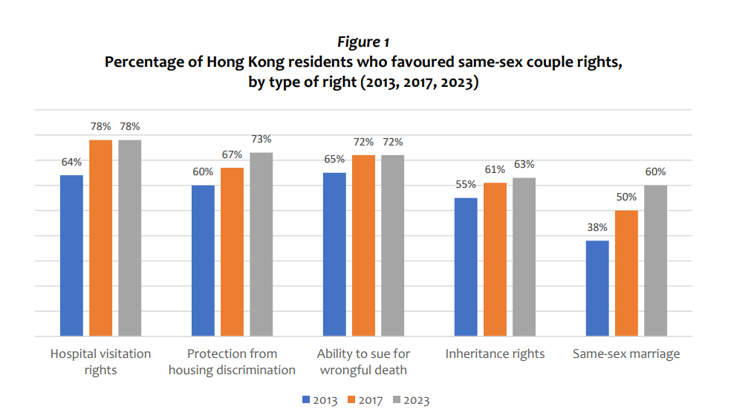
Most respondents did not know the public opinion on same-sex rights, misbelieving strong public objection over legalizing same sex marriage.
Despite different acceptance towards same-sex marriage, most respondents believe that most people in Hong Kong reject the idea of legalizing same sex marriage.
Instead, recent research results have showed that the community is moving towards in favor of more equal rights for same sex couple, including 60% of residents agreed with same-sex marriage. Effort shall be made to clearly communicate what the majority opinion is.
香港其實都仲係唔係好接受同性婚姻，雖然大家容忍程度高咗，但好多人都仲係用一種歧視眼光望人，覺得佢地唔符合自然特質，亦覺得佢地唔應該有下一代，因為會影響社會倫常。
Hong Kong society in general does not accept same sex marriage, although the tolerance level is higher. Many people are still discriminating, believe that they are not natural and shall not have off-spring, since it would affect social ethic norms.
[Aged 41-55,Male, Mildly Supportive]
2023 Data - Link
大部分應該係唔接受，因為基層人士佔大多數，如果同性夫妻拎咗啲福利，咁變相攞咗佢地啲福利。
Most shall not accept legalizing same-sex marriage, since the majority are grassroot. If same-sex couple can get welfare, it is like getting a hand into their own benefits.
[Aged 41-55, Male, Moveable Middle]

Slide 17
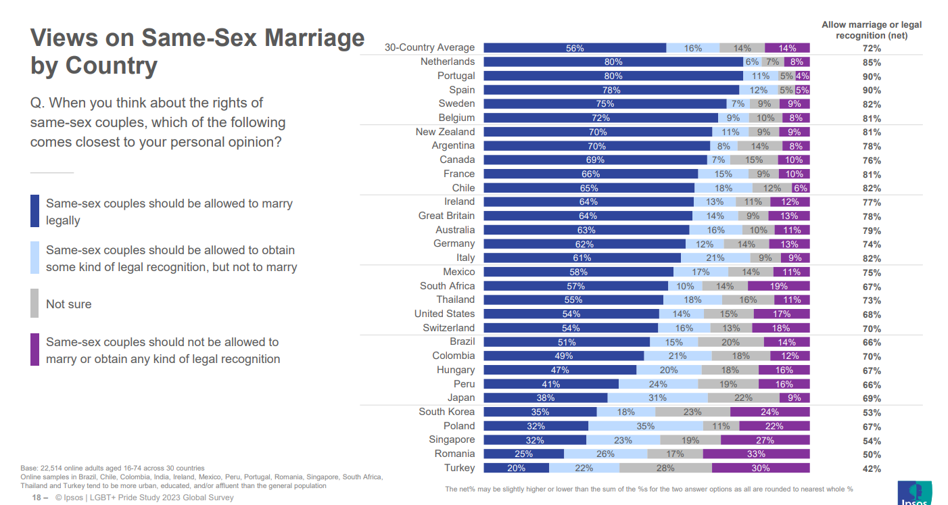
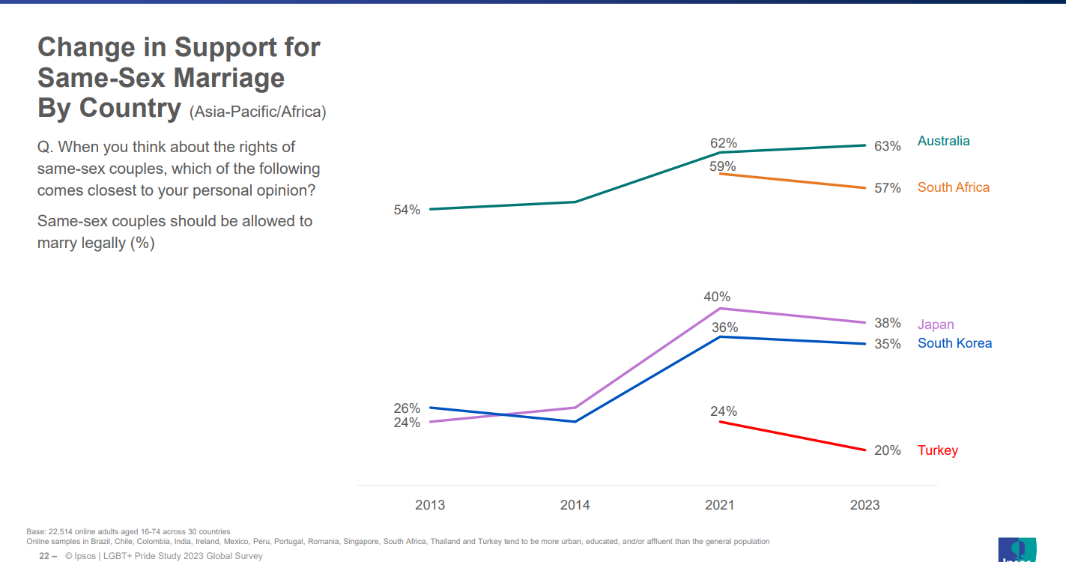
Recent Ipsos Study also showed Asia-Pacific countries are more supportive in same-sex marriage in the past decade, despite small set-back after Covid.
Some respondents also believe that while the western world is becoming accepting towards same sex marriage, it does not apply to Asia. While it is true that Asian countries are generally less accepting than the Western countries, data showed over half in JP, KR and SG are supportive of legal recognition of same-sex couples.
同性婚姻合法國家主要都係歐美國家， 亞洲地區好似得台灣， 我諗亞洲人都係prefer男同女嘅結合，係傳統觀念嘅道德影響。
Most countries allowing same sex marriage is in the west. In Asia there is only Taiwan. I think Asian prefer heterosexual, due to influence by traditional moral values.
[Aged 30-40, Male, Mildly Supportive]
2023 Data - Link

Slide 18
Summary
Moveable middles often relate same-sex with less eye-pleasing behaviors while less on love relationship.
LGBT+ allows communicating sexual diversity without the cultural bias but awareness is low among elders.
Most respondents did not know the public opinion on same-sex rights, misbelieving strong public objection over legalizing same sex marriage.
Recent Ipsos Study also showed Asia-Pacific countries are more supportive in same-sex marriage in the past decade, despite small set-back after Covid.
Food for thoughts:
Communicating same-sex love (romance) is more likely to be accepted than sexuality (behavior). People are more likely to connect with the daily relationship of same-sex couples over the affection.
Low awareness on the public opinion is a strong barrier in inciting more discussion on same-sex rights and marriage, as they do not find it a public demand.
International acceptance may not be relevant to rejectors. Strengthen communication on regional acceptance, including LGBT+ culture and movement in Asian countries.

Slide 19
Deep Dive in “Moveable Middles”

Slide 20
Proclaimed acceptance is high among moveable middles, but only if it can stay away from their personal life.
From the “Moveable Middles”
大家通常係容忍、接受，唔會指責出口或者特別醜化。
Findings is similar to those from 2019
We would tolerate and accept; I would not condemn or mock them.
[Aged 55-70, Male, Moveable Middles]
Most claimed they accept (tolerate and not obviously discriminating against) LGBT+ people, but prefer to have it hidden from the public scene.
Recognize a global trend in accepting same-sex marriage
Realize that co-existence would not lead to harm nor serious impact on them
See them as abnormality and believe it is better to cover up
Many know sexuality can be caused by genes, but also see it as a choice, of which one shall take responsibility for consequences.
Resistance is clearly noticed when it is personally encountered.
Their own children - most prefer that their children are not educated on sexual diversity, but confirm on majority
More private scenarios - such as public toilets
佢地始終都係genes不正常，係一個問題，咁就應該收埋。
All in all, they have abnormal gene. It is a problem (defect), then it shall be covered up.
[Aged 55-70, Male, Moveable Middles]
我認同香港係要改變嘅，但我更加認同 ‘條路自己揀，仆街唔好喊’，你可以揀移民，如果覺得咁喺香港生活好冇尊嚴
I agree HK needs to change. But even more than that, you have chosen this path so suck it up. If you find living like this in HK is condescending, you can choose to migrate.
[Aged 30-39, Male, Moveable Middles]
深水埗嗰啲公廁，知道有呢啲人，如果要去都係好尷尬。
In some public toilets, say those in Shum Shui Po, there are this kind of people (gay men). It’s very embarrassing if I have to use it.
[Aged 40-54, Male, Moveable Middles]

Slide 21
They justify their rejection by citing concerns over challenges to dominating doctrines like traditions, culture and nature.
From the “Moveable Middles”
我冇宗教，但例如天主教都有講係一男一女結合，咁天主教都好多人，你點樣扭轉呢啲諗法？
Most (especially male) expressed worry on negative social impact if traditions are violated.
1. Damage of harmony
Due to conflicts with traditional values, it is likely to lead to argument. The worry over political polarization and hostility lingers.
2. Disrespect to Chinese culture and values
Many moveable middles believe same-sex is more an issue of foreign culture. While they respect their difference, they do not want it to impact the HK culture which is “traditional”.
3. Against nature
They believe it is not natural and shall be discouraged, especially since it would negatively impact birth rate and population.
I do not have religion, but say Catholics believe marriage is of a man and a woman. There are many Catholics in HK. How can you change their thought.
[Aged 40-54, Male, Moveable Middles]
我地香港始終係傳統社會，冇咁容易接受。但我地可以行一個方向，如果外國人喺外國註冊咗，咁香港就要認可。如果係香港居民，就唔可以。唔係種族歧視，係每個國家有自己文化。
HK is a traditional society and it’s not easy to accept them. We can try this: if foreigners get married overseas, we will recognize. However, if they are HKers, we would not recognize. It is not racial discrimination, but respect to each country’s culture.
[Aged 55-70, Male, Moveable Middles]
同性婚姻等於絕子絕孫。
Same-sex marriage means no more offsprings.
[Aged 40-54, Male, Moveable Middles]
Gene可以係隱性。如果有人引誘，就會帶咗個genes出嚟。如果gene唔強，可能冇事。
Gene can be regressive. If it is induced by others, the gene will be brought out. If the gene is not strong, it will be fine.
[Aged 55-70, Male, Moveable Middles]
Notes:
我諗亞洲人都係prefer男同女嘅結合。 但係歐美重視自由，會重視每個人嘅權利。 呢個就係傳統觀念嘅道德影響。 同時相比下，香港都唔係一個追求自由嘅社會。 G1M
-而家婚姻制度對女士保障可能大啲，所以我會好奇會保障邊個多啲呢，個法例會點改變呢 Gp5F

Slide 22
They strongly worry about it spreading. Few even prefer that homosexual to conform with the norm and hide their needs.
From the “Moveable Middles”
我都識一個同性戀男，結婚生咗小朋友。因為離咗婚，2個仔都唔知佢係同性戀。佢地因為社會壓力而同異性結婚，咁對社會都係好事嚟嘅 。
They believe that signaling the acceptance of homosexuality and same-sex marriage will “seduce” more to become “abnormal”, so they feel a moral obligation to reject.
Recognize that it is more common to see same sex couples in the society (increased exposure in mass media, workplace and on street), suggesting that the behavior is spreading
Some people change sexual preference mid-life, meaning it is not always biological and can be socially influenced
Few worry that the LGBT+ will ask for more and more from the society once they conform.
They also prefer to prevent children to receive LGBT+ related information and object family formation by LGBT+.
Discomfort to discuss the topic with kids
Confusion of family structure and roles of father and mother
Concern over interaction with kids from LGBT family.
Usage of surrogate pregnancy may lead to incest
I know a homosexual man who got married and had kids. He was divorced and both kids do not know his sexuality. They married another sex due to social pressure, and I think it is a good thing for the society.
[Aged 55-70, Female, Moveable Middles]
立法可能造成同性戀者肆無忌憚，佢可以好公開自己係同性戀，或者引誘年輕人，呢樣嘢係我最討厭，鼓勵咗呢種風氣。佢天生咪搵返啲天生gay嘅，唔好影響更多人。
They may become boundless once legislated. They can publicly claim homosexuality or seduce young people. I really hate that they spread this trend. If they are born gay, go find others who are born gay too but do not affect more people.
[Aged 55-70, Female, Moveable Middles]
2個公公咁樣，佢地領養下一代小朋友會將個abnormal elaborate咗。
Raised by two queers, their adopted kid will then further elaborate their abnormality.
[Aged 30-40, Male, Moveable Middles]
我覺得單親家庭仲好過呢種同性家庭。
Family of single parent Is better than family of same-sex parents.
[Aged 55-70, Male, Moveable Middles]

Slide 23
Fear against disruption to legal and welfare system is commonly found among moveable middles.
From the “Moveable Middles”
我覺得香港對佢地都算friendly，算係一個安穩嘅環境比佢地相愛，比起歧視傷殘人士，歧視同性戀應該算好少。
Many believe the change of law does not resolve discrimination and it is not worthwhile to bring disruption to the legal system
Law cannot change discrimination
Reasonably good life for same-sex couple now, and they can seek other legal means to reach same goals
More visible and less taboo to talk about
Can get married overseas to demonstrate commitment
Can live together like a couple at personal expense
Low chance to get the bill passed, thus not worthwhile to try
Many also expressed worry over exhausting social resources by granting the equal rights in welfare.
Competition for resources like public housing
More government expenses (e.g. civil servant benefits) and less tax
HK is a friendly place for them. They can love in a stable environment. Comparing to the disabled, I think they face less discrimination.
[Aged 55-70, Male, Moveable Middles]
係咪樣樣嘢都要立法呢？你立咗法都唔代表冇歧視㗎。性別歧視你話而家有冇呢？請人背後都有自己嘅judgement，佢唔講俾你聽之嘛。
Do we need legislation on everything? There can be discrimination even if there is a bill. Is there gender discrimination? Everyone makes personal judgement in hiring. They just do not tell you.
[Aged 30-40, Male, Moveable Middles]
本身呢個社會就好難做到所有嘢都平等，就算鍾意異性嘅人喺婚姻上都可以俾人歧視㗎，例如離婚人士，咁點解唔保障離婚人士呢？
It is impossible to make everything equal in the society. Heterosexual can be discriminated by their marriage status too, like divorcees. Why don’t you legislate to protect divorcees?
[Aged 41-55, Male, Moveable Middles]
我覺得佢地唔應該有法定地位，因為會有福利，咁就攞咗政府好多資源，e.g.公屋、報稅，演變落去會有好多問題，要睇呢個社會承唔承擔到。
I do not think they shall have legal status as it will lead to benefits. They will take resources from the government, like public housing, tax. It will lead to more problem as the society may not be able to afford.
[Aged 41-55, Male, Moveable Middles]
Notes:
•而家嘅歧視已經輕咗，冇以前咁勁㗎喇 GP4F
如果真係鍾意對方，自由戀愛、同居冇問題，但結婚涉及好多法律上問題，責任都比較大。我而家呢刻都未接受到 Gp2F
-我覺得單親家庭仲好過呢種同性家庭 Gp6 M

Slide 24
Summary
Proclaimed acceptance is high among moveable middles, but only if it can stay away from their personal life.
They justify their rejection by citing concerns over challenges to dominating doctrines like traditions, culture and nature.
They strongly worry about it spreading. Few even prefer that homosexual to conform with the norm and hide their needs.
Fear against disruption to legal and welfare system is also commonly found among moveable middles.
Food for thoughts:
Education against discrimination is effective in preventing overt opposition and aggressive actions against the LGBT+ community, even if it may not eliminate bias.
The fear on uncertainty after change is real, but they may be settled by communication on facts, e.g. whether legalizing same-sex marriage would lead to declining birth rate or strong increase in population identified with homosexual preference.
Legal perception affects willingness to change law. Joint force with groups in progressive legal reform to eradicate injustice.

Slide 25
Deep Dive in “Mildly Supportive”

Slide 26
Increased understanding (via visibility & LGBT+ they know) encourage embracing equal rights towards same-sex couples.
From the “Mildly Supportives”
香港係國際城市，唔系咁封閉，或者思想唔係咁原理踏步㗎嘛。社會喺度轉變，會慢慢接觸到原來世界上仲有啲另類嘅愛，原來係OK㗎喎，坦白講我又唔係同性戀，冇咩影響到我嘅啫。
The change of attitudes mainly comes from 3 reasons:
1. Agreeing to the global trend in diversity and inclusion
2. Witnessing the suffering of same-sex couples
3. Understanding the love life of a same-sex couple is not that different from that of a heterosexual couple
HK as an international city shall not be closed or non-progressive. The society is changing. People get to learn that there are alternatives in love and that was okay. Honestly, I am not gay and it would not affect me.
[Aged 30-40, Male, Mildly Supportive]
香港係國際大都市，咩都應該要接受。
HK is a global metropolis. We shall have higher acceptance.
[Aged 55-70, Male, Mildly Supportive]
最近有新聞，有個男同志喺酒店房到死咗，大家嘅焦點都去咗男同志，而唔係死咗一個人咯。死咗已經好慘，點解仲要笑人嘅性取向？
張國榮係一個悲劇，點解要搞到人地咁淒慘呢？要改變我地嘅眼光 。
Leslie Cheung is a tragedy. Why shall we make others suffer? We shall change our view.
[Aged 55-70, Male, Mildly Supportive]
A recent news said a gay man died in a hotel room. People only focus on gay, not that a man died. Death is a sad thing. Why would they still use this to mock on sexuality?
[Aged 30-40, Female, Mildly Supportive]
我上網睇直播會見到啲同性couple分享自己生活、相處，見到佢地有埋bb，都覺得凳佢地開心，見到佢地有幸福嘅感覺。
喺youtube度睇鄧達智同佢老公都生活得好開心。
I saw videos of same-sex couples sharing their lives, interaction. They also have babies. I was happy for them and shared a sense of well being.
[Aged 40-54, Female, Mildly Supportive]
From YouTube, I saw William Tang and his husbands live happily.
[Aged 55-70, Male, Mildly Supportive]

Slide 27
Some objections are still observed among mildly supportives on child-rearing and challenging traditional setting.
From the “Mildly Supportives”
唔太支持有下一代，好難面對，可能有倫常問題。佢地養寵物比較好。
Resistance noticed when it comes to
1. Rights in Childrearing
Few parents prefer that same-sex couples to not have kids for worries over education of family values.
2. Using the term as marriage
Respondents with religious belief prefer to confine the term marriage to heterosexual couples but are open to equalize rights to legally-recognized same-sex couples.
3. Equalizing rights in religion setting
Respondents with religious belief prefer to confine the term marriage to heterosexual couples but are open to equalize rights to legally-recognized same-sex couples.
Do not support them to have offspring for potential moral issues. It’s better if they just have pets.
[Aged 40-54, Male, Mildly Supportive]
到時啲小朋友叫邊個做爸爸、媽媽呢？感覺會混亂。
So who are the dad and mom for the kids? Feels confusing.
[Aged 30-40, Female, Mildly Supportive]
佢地做法定配偶，爭取平權係冇問題嘅。
They can be legal couple and fight for equal rights.
[Aged 40-54, Male, Mildly Supportive]
同性可以喺香港註冊，但唔好喺教堂行禮，唔合乎宗教。
Same sex couples can register in HK but not carry out ceremony at church since it does not abide. They can be legal couple and fight for equal rights.
[Aged 40-54, Male, Mildly Supportive]

Slide 28
Change is possible. Mildly supportives say these regarding why they now believe it is better to change and equalize.
No need to worry too much. Change is natural.
To achieve equality, the society need to invest. The investment will lead to growth.
Legitimacy can speed up equality. There is nothing wrong to change a law.
而家啲小朋友上網都會睇到好多嘢， 佢哋基本上都接受到一啲新潮啲嘅嘢。
The kids nowadays can go online and see many things. They in principle accept modern concepts and things.
[Aged 30-40, Female, Mildly Supportive]
你擔心唔到咁多下一代，佢地始終都要面對個社會
You cannot worry too much about the next generation. Eventually they will need to face the society.
[Aged 55-70, Male, Mildly Supportive]
傳統都係時間累積，個世界會慢慢變。當累積到一定程度，大家就會無所謂。
Traditions are accumulated and the world is changing. Once accumulated to a certain level, people would realize it does not matter.
[Aged 55-70, Male, Mildly Supportive]
佢地收養小朋友都幾好，破碎家庭嘅小朋友好慘
It’s good if they can adopt kids who are suffering from a broken family.
[Aged 55-70, Male, Mildly Supportive]
都會有好多人可以靠呢啲嘢嚟搵錢， 例如結婚套餐，婚紗拍攝，一定有生意。
People can also make money around it, like marriage banquet, photo-shooting, there will be business.
[Aged 30-40, Male, Mildly Supportive]
姨甥女係營養師，同個女醫生一齊咗，佢地喺香港冇辦法有status，而家喺加拿大結咗婚。咁樣令到香港無咗兩個專業人士。
My nephew is a nutritionist and is in love with a female doctor. They can’t have status here, so they go to Canada and get married. Because of this, HK loses two professionals.
[Aged 41-54, Male, Mildly Supportive]
佢地爭取緊公平嘅機會，男女可以結婚，點解佢地唔可以呢？法律可以改㗎嘛。
本身香港婚姻嘅條例係跟英國，男女結合， 我覺得係咪係時候Review吓啲條例唔一定要跟原本嘅法律。
They are fight for a fair chance. Man and woman can get married, why can’t they? Law can be changed.
[Aged 40-54, Male, Mildly Supportive]
The marriage law in HK is inherited from England, thus a man and a woman. I think it may be the time to review whether we need to follow the original law.
[Aged 30-40, Female, Mildly Supportive]

Slide 29
Summary
Increased understanding (via visibility & LGBT+ they know) encourage embracing equal rights towards same-sex couples.
Some objections are still observed among mildly supportives on child-rearing and challenging traditional setting.
Change is possible. Mildly supportives are convinced by the following messages:
No need to worry too much. Change is natural.
To achieve equality, the society need to invest. The investment will lead to growth.
Legitimacy can speed up equality. There is nothing wrong to change a law.
Food for thoughts:
Increasing visibility and LGBT+ community to come out is helpful in garnering support from a bottle-up approach.
Child-rearing by same-sex couple is more controversial than other same-sex rights.

Slide 30
Reaction to LGBT+ Communications

Slide 31
News report is the most effective communication channel to both Moveable Middles and Mildly Supportives.
By order of impact level (from high to low)
News report / program
Most respondents are not attentive to nor interested in LGBT+ movies, TVs or ads for entertainment. Some moveable middles may even reject such information when it is too LGBT+ focused.
Meanwhile, LGBT+ news (e.g. on legal cases) on conventional TV news reports were able to penetrate into their daily life and draw attention.
Popular LGBT+ movies, TVs and ads however can play a role in demonstrating public support – their success can also allow a more casual discussion on LGBT+ topics without resulting in political discussion or heated arguments.
Celebrities
Movies
TV drama
Advertisements
Other art forms

Slide 32
News reports on LBGT court case demonstrated legitimacy and communicated the challenges same-sex couples face.
Conventional TV news reports remain a strong habit for many mature respondents. It is an effective channel to connect with people of different views.
Discriminatory policies against same-sex couple were bought to public attention due to court cases.
News reports put clear commoners’ faces to the discriminatory incidents, making the suffering more personal and vivid.
Respondents recall cases that call for joint income tax assessment, spouse benefits for gay civil servants, application of public housing, as well as legal entitlements under intestacy and inheritance laws.
Empathy is strong when cases are related to life & death.
Helplessness draws empathy: the more mature the respondents, the more able they are in understanding the difficulties in life and empathize with the helpless situations.
Many find strong resonance and feel the pain of LGBT+ couples when they were not able to have the same rights in issue related to life and death, e.g. inheritance, medical treatment, handling of bodies or remains.
By order of impact level (from high to low)
News report / Non-LGBT program
Celebrities
Movies
TV drama
Advertisements
Other art forms
Notes:
無線有播過他鄉故事，個男仔嫁咗鬼佬，佢話唔想分身家或者任何福利，佢只係要個配偶所有嘅愛，呢啲係ok嘅。 Gp6 F

Slide 33
Same-sex celebrity couples help to demonstrate the beauty and normality of same-sex love relationship
By order of impact level (from high to low)
Celebrities are attention-drawing. Their messages often get across more effectively than NGOs.
Appeal towards celebrities can transmit into empathy and willingness to accept their preference.
Local celebrities mentioned include Leslie Cheung, Anthony Wong, Denise Ho, William Tang, Vinci Wong, Kayla Wong, Gigi Chao.
International celebrities can also have similar impact, e.g. Tom Daley.
The sharing of everyday life experience with their same-sex couple are considered warm and resonating.
News report / program
Celebrities
Movies
TV drama
英國跳水嗰個靚仔都領養咗。
The handsome English diver has also adopted a kid.
[Aged 55-70, Female, Moveable Middles]
Advertisements
Other art forms

Slide 34
Movies and TV drama bring awareness to LGBT+ communities but most do not relate them to the equality movement.
LGBT+ movies are common on Netflix. It is effective in reaching out to the younger groups, but parents have expressed concerns over early encounter of their kids.
Awareness and usage of local LGBT+ movies is not common among the respondents. Strong WOM or industry recognition may drive interest.
Few respondents remember seeing blockbuster Brokeback Mountain as an early experience in LGBT+ movie.
1-2 respondents have watched Tracey and/or Suk Suk because they are award-winning movies.
TV drama, Ossan’s Love, is well-aware. About 1/4 of respondents have watched it, including some moveable middles. Few have watched Boyscation out of curiosity.
It brings awareness to the LGBT+ community, although some may not see them as related to the quest in equality.
By order of impact level (from high to low)
News report / program
Celebrities
Movies
TV drama
Advertisements
Other art forms
我諗呢啲宣傳都係為咗話比大家聽係有呢種群體嘅，而唔係真係去到要爭取某啲嘢
I think these promotion is to tell people that these communities exist, but not to fight for anything.
[Aged 40-54, Female, Moveable Middles]
Notes:
-好多長輩睇大叔的愛，我都有問返佢地對同性戀睇法，佢地都係話拍劇㗎姐，睇完咪算囉 Gp1 M

Slide 35
Younger respondents were more able to recall LGBT+ themed advertisements. Engagement in other art forms is low.
Few respondents, mainly younger ones, were able to recall seeing LGBT+ themed advertisement, including
HSBC ad with a female couple
Wedding ring ad
Hotel ad
Many believe these advertisement are mainly distributed on social media instead of conventional TV channels, thus less able to reach the mature population.
LGBT+ themed arts, including theatre and visual art exhibition, have low awareness and even lower usage.
One Moveable Middles attended the visual arts exhibition at Tai Kwun. She considered the event rather exclusive with relatively little publicity.
By order of impact level (from high to low)
News report / program
有呢啲廣告㗎咩？咁大膽喺電視播？YouTube就有啩，無線唔敢㗎
Are there such ads? So brave to play on TV? Maybe YouTube but not on TVB.
[Aged 55-70, Male, Moveable Middles]
Celebrities
Movies
TV drama
Advertisements
對於呢啲活動，我都係尊重，呢班人想表達自己嘅野，係要有渠道。但唔好過多promote，最好唔好搞咁多喇。
Other art forms
I respect these activities as they need channels to express themselves. However, it shall not be broadly promoted, and best to not have too many of them.
[Aged 55-70, Male, Moveable Middles]
Notes:
對於呢啲活動，我都係尊重喇，呢班人想講/表達自己嘅野，係有渠道。但唔好過多promote，最好唔好搞咁多喇

Slide 36
Reactions on high profile event is controversial. Many see the events as just eyeball catching.
Food for thoughts:
Organizers shall clearly communicate the format of the event and intended message so people can understand beyond the eye-catching scenes.
To help mitigate concerns on kids, event organizers may consider preparing education materials to help parents explain the events and the meaning behind people’s behaviors, including ways to respond to kids’ questions and how to react to community demonstrating different habits.
People believe that the core objective of these activities is to get public attention on LGBT+ communities.
Supporters believe these activities open up people’s mind and are helpful in teaching diversity.
Conservatives dislike eye-catching outfit, thinking they bring challenges in kids’ upbringing.
我覺得係要keep住搞活動，接觸得多、薰陶得多，思想會容易接受多啲。教育下一代係好依賴呢類型的活動，e.g.遊行、嘉年華。
I think we need to keep holding these activities. The more you see and engage, the more open-minded you become. It is important for educating our next generation via Parade and Fair.
[Aged 30-39, Female, Mildy Supportive]
同樂運動會仲要搵啲人過嚟，真係搞搞震。我唔知佢運動會係咩形式，如果好似啲遊行咁暴露，真係想嘔㗎。我覺得外籍人士會參與得多啲。
Gay Games even invites people from overseas to come. Just messing around. I do not know what the games’ format to be. If it is with revealing outfit like Parade, it makes me puke.
[Aged 55-70, Female, Moveable Middles]
喺weekend搞呢啲活動，一家大細都會睇到， 會影響下一代㗎嘛。 我反感嘅位係奇裝異服，同埋喺公眾地方做親密嘅行為， 我係覺得好尷尬。
Holding these events over the weekend means it will be seen by family with kids and affect them. I particularly dislike the strange outfits and public intimacy. It makes me feel embarrassed.
[Aged 40-54, Male, Moveable Middles]

Slide 37
Awareness in the inequality faced by same-sex couple is low. When given more details, we notice more moveable middles are accepting their requests for medical-related rights.
By order of acceptance level (from high to low)
原來佢地生活係受到咁多考驗，你申請唔到公屋逼住租樓住。如果另一半走咗，公屋要迫遷。
Health and Accident Handling
I did not know they have to face so many challenges in life – one cannot apply for public housing as a couple, thus need to rent. Even if getting public housing, one has to be vacated if the partner is deceased.
[Aged 30-39, Female, Moveable Middles]
Same sex couple cannot decide on spouse’s medical treatment nor get travel-industry subsidy for attending spouse’s accident overseas
Death Arrangement
Issues related to life and death are particularly resonating to the more mature groups. Many are okay for them to seek equality in the areas.
Same sex couple cannot collect ashes without family consent nor bury together in govt cemetery
性命攸關嘅嘢係可以爭取㗎，醫療嗰啲
For issues like medical that is about life and death, it is okay to fight for equality.
[Aged 55-70, Female, Moveable Middles]
Property Tax
Same sex couple of international background may have to pay 4 times tax amount for property purchase
我覺得醫療方面係要幫下佢地，譬如要緊急做手術，如果另一半冇得幫佢簽紙，唔通睇住佢去死咩，應該要比簽紙權利佢地。你話等到2個主診醫生判斷，唔係唔得，但係會拖好長時間，可能病情都惡化咗喇。另外領取遺體都應該要批准
I think we need to help them on medical issue, like urgent surgery, if the spouse cannot sign for him, would you just watch and let him die? We shall give right for them to authorize. You may say they can wait to get two doctors’ consent, but it will delay and health may deteriorate. Also, they shall also be allowed to get the remains.
[Aged 55-70, Male, Moveable Middles]
Inheritance
Same sex couple cannot keep public housing nor collect pension from deceased spouse

Slide 38
For rights related to wealth and welfare, including tax exemption, insurance or pension, moveable middles are less keen in supporting equal rights.
By order of acceptance level (from high to low)
Issues related to welfare are considered use of public resources, which many moveable middles perceive as benefits instead of rights. Since it is benefit, the decision is subject to the grantor, which is the HK government.
Health and Accident Handling
Same sex couple cannot decide on spouse’s medical treatment nor get travel-industry subsidy for attending spouse’s accident overseas
佢哋行緊呢條路的確係預咗冇正常夫妻嘅福利。我都覺得平權係可以喺商界出發，唔一定要透過同性婚姻合法化。
Death Arrangement
They have chosen this path and shall expect not to have the benefits of a normal couple. I think equal rights may start from business instead of legalizing same-sex marriage.
[Aged 40-54, Female, Moveable Middles]
Same sex couple cannot collect ashes without family consent nor bury together in govt cemetery
Property Tax
Same sex couple of international background may have to pay 4 times tax amount for property purchase
佢地做決定嘅時候已經知道自己嘅status會係咁，咁你點解仲要去爭取所謂嘅權益呢？因為你本身係冇㗎嘛，你唔好覺得你本身係有。呢個社會到呢剎那都係冇呢個social norm㗎嘛，我覺得佢地有少少自私嘅。
They know the status when decide on the path. Why would you still fight for the so-called rights? You are not entitled to it, so do not assume it is a right. At this moment, the society does not have that social norm. I feel that they are selfish.
[Aged 30-39, Male, Moveable Middles]
Inheritance
Same sex couple cannot keep public housing nor collect pension from deceased spouse
Notes:
遺產，其實可以用保險嘅方式處理到
• 我記得簽紙做手術都可以搵律師幫手，係解決到嘅

Slide 39
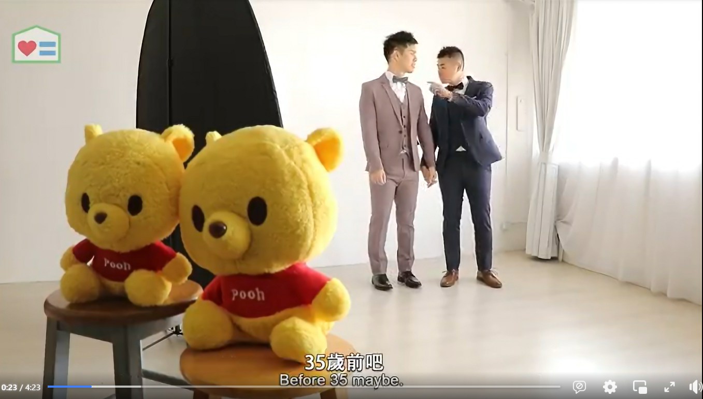
Telling real stories of same-sex couples are effective in drawing empathy among mildly supportive groups, but scene of intimacy and discussion of child-rearing draws rejection from mature moveable middles.
During the focus groups, we showed respondents a video of the story between Dino and Geoffrey.
The reaction is largely positive among the mildly supportive groups, who can empathize with the challenges they faced and strengthen belief in the pursuit of equality.
However, skepticisms or even rejection are observed in the groups of moveable middles, particularly triggered by the discomfort in kissing scenes, the desire in getting welfare and the goal to raise up two kids as a couple. Only 2 moveable middles (total 18) expressed “blessing” to the couple, and 5 mentioned that they are fine with their quest to fight for equal rights (although not marriage).

Slide 40
Among the messages mentioned, while many moveable middles show sympathy in medical and ash handling, many are convinced there are better solution than legal change.
For the mildly supportive, the video clearly presents the challenge same-sex couple faces and fortifies that there are work to be done for equal rights.
我覺得點解要對佢地唔公平，例如做手術簽紙，點解佢地乜都唔可以嘅？好多權利係佢地應該要有。
I reflect, why the society treats them so unfairly? Say signing documents for operation, why can’t they do this? They shall be entitled to many rights.
[Aged 55-70, Female, Mildly Supportive]
About 1/4 moveable middles find it is okay for them to try to ask for more rights.
Most moveable middles still feel that they should seek other solutions instead of trying to change the current system.
我嘅認可就未必有，反而我覺得係佢哋嘅團體要向政府爭取多啲， 始終佢哋屬於小眾，唔會有咁多人support，佢哋只能夠自己爭取。
關於骨灰嗰樣，我覺得唔係由立法去俾呢個權利佢，而係喺律師方面去做啲嘢。 律師嗰邊有張紙簽咗就可以委託一個人代你去做決定。 只要將個授權擴大就可以，你應該係爭取呢一樣嘢而唔係爭取同性婚姻。
I may not endorse them but agree that their organization shall fight with the government for more. They are minority and not many people would be supporting them, so they must fight for themselves.
[Aged 40-54, Female, Moveable Middles]
Regarding ash handling, I do not think it shall be resolved by legal reform. Attorney can handle this. You can sign a document at attorney to authorize a representative to handle personal matters. You only need to fight to request the expansion on this authorization, instead of legalizing marriage.
[Aged 40-54, Male, Moveable Middles]

Slide 41
Summary
News report is the most effective communication channel to both Moveable Middles and Mildly Supportives.
News reports on LBGT court case demonstrated legitimacy and communicated the challenges same-sex couples face.
Same-sex celebrity couples help to demonstrate the beauty and normality of same-sex love relationship.
Movies and TV drama bring awareness to LGBT+ communities but most do not relate them to the equality movement.
Younger respondents were more able to recall LGBT+ themed advertisements.
Engagement in other art forms is low.
Reactions on high profile event is controversial. Many see the events as just eyeball catching.
Food for thoughts:
Lawsuits in equal rights have much bigger impact than the result of the case itself. The battleground shall be maintained.
For high-profile events, organizers shall clearly communicate the format of the event and intended message beforehand so that people can understand beyond the eye-catching scenes.
To help mitigate concerns on kids, event organizers may consider preparing education materials to help parents explain the events and the meaning behind people’s behaviors, including ways to respond to kids’ questions and how to react to community demonstrating different habits.

Slide 42
Summary
Awareness in the inequality faced by same-sex couple is low.
When given more details, we notice more moveable middles are accepting their requests for medical-related rights.
Issues related to life and death are particularly resonating to the more mature groups. Many are okay for them to seek equality in the areas.
For rights related to wealth and welfare, including tax exemption, insurance or pension, moveable middles are less keen in supporting equal rights.
Telling real stories of same-sex couples are effective in drawing empathy among mildly supportive groups, but scene of intimacy and discussion of child-rearing draws rejection from mature moveable middles.
Among the messages mentioned, while many moveable middles show sympathy in medical and ash handling, many are convinced there are better solution than legal change.
Food for thoughts:
Use real stories to communicate the challenges same-sex couple face is an effective mean to strengthen the belief in equality pursuit among the mildly supportive ones and get some sympathy from the moveable middle groups.
Concern on health is universal and can build resonance with the more mature group. Rights related to medical and death arrangement can be good entry point for communication.
Controversial execution may cause rejection. Use scenes of same-sex kissing and discuss same-sex parenting with care.

Slide 43
Summary
© Ipsos

Slide 44
Summary (1) - Values & Meaning of Marriage
The society seeks to be more peaceful with less conflicts.
There is no particular difference in the view of marriage between moveable middles and mildly supportives.
The meaning of marriage is changing. The younger generation finds less social pressure in getting married.
Food for thoughts:
Maintaining peaceful discussion on same-sex couple rights and marriage equality is important to bring the message across. It may be helpful to have guidelines and tips to facilitate such communication with friends, family and colleagues.
The reduced pressure towards marriage can be a double-edge sword. While people accept changing meaning for marriage, some may believe it to be less important and thus not worth fighting for. Communicate the importance of marriage to a couple beyond responsibility and family formation.

Slide 45
Summary (2) - Perception to LGBT+ & Same Sex Marriage
Moveable middles often relate same-sex with less eye-pleasing behaviors while less on love relationship.
LGBT+ allows communicating sexual diversity without the cultural bias but awareness is low among elders.
Most respondents did not know the public opinion on same-sex rights, misbelieving strong public objection over legalizing same sex marriage.
Recent Ipsos Study also showed Asia-Pacific countries are more supportive in same-sex marriage in the past decade, despite small set-back after Covid.
Food for thoughts:
Communicating same-sex love (romance) is more likely to be accepted than sexuality (behavior). People are more likely to connect with the daily relationship of same-sex couples over the affection.
Low awareness on the public opinion is a strong barrier in inciting more discussion on same-sex rights and marriage, as they do not find it a public demand.
International acceptance may not be relevant to rejectors. Strengthen communication on regional acceptance, including LGBT+ culture and movement in Asian countries.

Slide 46
Summary (3) - Deep Dive in “Moveable Middles”
Proclaimed acceptance is high among moveable middles, but only if it can stay away from their personal life.
They justify their rejection by citing concerns over challenges to dominating doctrines like traditions, culture and nature.
They strongly worry about it spreading. Few even prefer that homosexual to conform with the norm and hide their needs.
Fear against disruption to legal and welfare system is also commonly found among moveable middles.
Food for thoughts:
Education against discrimination is effective in preventing overt opposition and aggressive actions against the LGBT+ community, even if it may not eliminate bias.
The fear on uncertainty after change is real, but they may be settled by communication on facts, e.g. whether legalizing same-sex marriage would lead to declining birth rate or strong increase in population identified with homosexual preference.
Legal perception affects willingness to change law. Joint force with groups in progressive legal reform to eradicate injustice.

Slide 47
Summary (4) - Deep Dive in “Mildly Supportives”
Increased understanding (via visibility & LGBT+ they know) encourage embracing equal rights towards same-sex couples.
Some objections are still observed among mildly supportives on child-rearing and challenging traditional setting.
Change is possible. Mildly supportives are convinced by the following messages:
No need to worry too much. Change is natural.
To achieve equality, the society need to invest. The investment will lead to growth.
Legitimacy can speed up equality. There is nothing wrong to change a law.
Food for thoughts:
Increasing visibility and LGBT+ community to come out is helpful in garnering support from a bottle-up approach.
Child-rearing by same-sex couple is more controversial than other same-sex rights.

Slide 48
Summary (5) – Channels of LGBT+ Communications
News report is the most effective communication channel to both Moveable Middles and Mildly Supportives.
News reports on LBGT court case demonstrated legitimacy and communicated the challenges same-sex couples face.
Same-sex celebrity couples help to demonstrate the beauty and normality of same-sex love relationship.
Movies and TV drama bring awareness to LGBT+ communities but most do not relate them to the equality movement.
Younger respondents were more able to recall LGBT+ themed advertisements.
Engagement in other art forms is low.
Reactions on high profile event is controversial. Many see the events as just eyeball catching.
Food for thoughts:
Lawsuits in equal rights have much bigger impact than the result of the case itself. The battleground shall be maintained.
For high-profile events, organizers shall clearly communicate the format of the event and intended message beforehand so that people can understand beyond the eye-catching scenes.
To help mitigate concerns on kids, event organizers may consider preparing education materials to help parents explain the events and the meaning behind people’s behaviors, including ways to respond to kids’ questions and how to react to community demonstrating different habits.

Slide 49
Summary (6) – Reactions on LGBT+ Communications
Awareness in the inequality faced by same-sex couple is low.
When given more details, we notice more moveable middles are accepting their requests for medical-related rights.
Issues related to life and death are particularly resonating to the more mature groups. Many are okay for them to seek equality in the areas.
For rights related to wealth and welfare, including tax exemption, insurance or pension, moveable middles are less keen in supporting equal rights.
Telling real stories of same-sex couples are effective in drawing empathy among mildly supportive groups, but scene of intimacy and discussion of child-rearing draws rejection from mature moveable middles.
Among the messages mentioned, while many moveable middles show sympathy in medical and ash handling, many are convinced there are better solution than legal change.
Food for thoughts:
Use real stories to communicate the challenges same-sex couple face is an effective mean to strengthen the belief in equality pursuit among the mildly supportive ones and get some sympathy from the moveable middle groups.
Concern on health is universal and can build resonance with the more mature group. Rights related to medical and death arrangement can be good entry point for communication.
Controversial execution may cause rejection. Use scenes of same-sex kissing and discuss same-sex parenting with care.

Slide 50
“We must be willing to give up the life we have planned so as to have the life that is waiting for us” ~ Joseph Campbell
© Ipsos

